Slide 1
Project 8. Twitter COVID19 Network Analysis II
Matt Stirling
Consider the TweetsCOV19 dataset, a semantically annotated corpus of Twitter about COVID19 aiming at capturing online discourse about various aspects of the pandemic and its social impact.

Slide 2
Project Specification
Dataset: https://zenodo.org/records/3871753

Slide 3
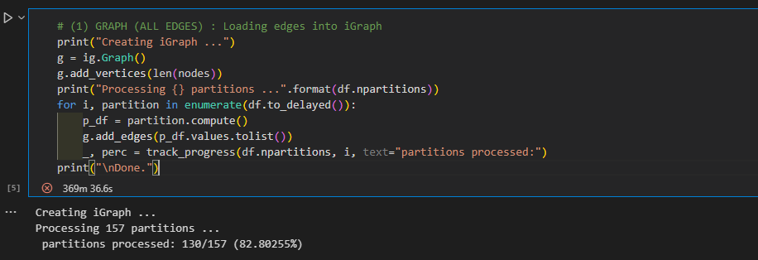

Slide 4
